Slide 1
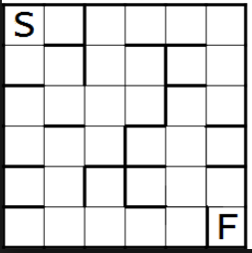
PROBLEM STATEMENT
SOLVE THE MAZE
Given a maze you are supposed to travel from start to finish node using the shortest path. Solve the problem using Dijkstra’s algorithm. Solution must be adaptable to similar problems.

Slide 2
Dijkstra’s algorithm
Dijkstra's algorithm is an algorithm for finding the shortest paths between nodes in a graph, which may represent, for example, road networks. It was conceived by computer scientist Edsger W. Dijkstra in 1956 and published three years later.
The algorithm exists in many variants; Dijkstra's original variant found the shortest path between two nodes, but a more common variant fixes a single node as the "source" node and finds shortest paths from the source to all other nodes in the graph, producing a shortest-path tree.
For a given source node in the graph, the algorithm finds the shortest path between that node and every other. It can also be used for finding the shortest paths from a single node to a single destination node by stopping the algorithm once the shortest path to the destination node has been determined. For example, if the nodes of the graph represent cities and edge path costs represent driving distances between pairs of cities connected by a direct road, Dijkstra's algorithm can be used to find the shortest route between one city and all other cities.
Dijkstra’s algorithm solves the single-source shortest-paths problem on a weighted, directed graph G =(V,E) for the case in which all edge weights are non negative. Therefore, we assume that w(u,v) >= 0 for each edge (u , v) Є E. Dijkstra’s algorithm maintains a set S of vertices whose ﬁnal shortest-path weights from the source s have already been determined. The algorithm repeatedly selects the vertex u Є V - S with the minimum shortest-path estimate, adds u to S, and relaxes all edges leaving u. In the following implementation, we use a min-priority queue Q of vertices, keyed by their d values.

Slide 3
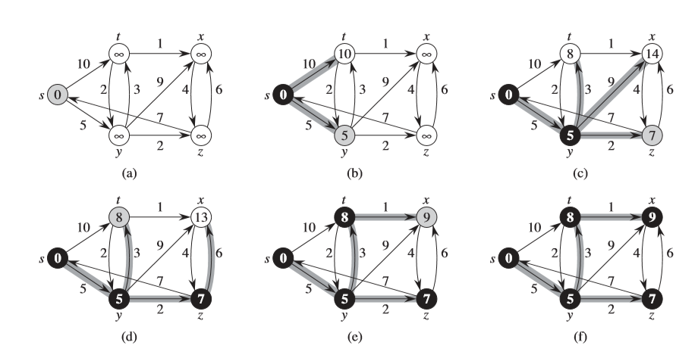
The execution of Dijkstra’s algorithm. The source s is the leftmost vertex. The shortest-path estimates appear within the vertices, and shaded edges indicate predecessor values. Black vertices are in the set S, and white vertices are in the min-priority queue Q=V-S . (a) The situation just before the ﬁrst iteration of the while loop of lines 4–8. The shaded vertex has the minimum d value and is chosen as vertex u in line 5. (b)–(f) The situation after each successive iteration of the while loop. The shaded vertex in each part is chosen as vertex u in line 5 of the next iteration. The d values and predecessors shown in part (f) are the ﬁnal values.

Slide 4
ALGORITHM
Let the node at which we are starting be called the initial node. Let the distance of node Y be the distance from the initial node to Y. Dijkstra's algorithm will assign some initial distance values and will try to improve them step by step.
Assign to every node a tentative distance value: set it to zero for our initial node and to infinity for all other nodes.
Set the initial node as current. Mark all other nodes unvisited. Create a set of all the unvisited nodes called the unvisited set.
For the current node, consider all of its unvisited neighbors and calculate their tentative distances. Compare the newly calculated tentative distance to the current assigned value and assign the smaller one. For example, if the current node A is marked with a distance of 6, and the edge connecting it with a neighbor B has length 2, then the distance to B (through A) will be 6 + 2 = 8. If B was previously marked with a distance greater than 8 then change it to 8. Otherwise, keep the current value.
When we are done considering all of the neighbors of the current node, mark the current node as visited and remove it from the unvisited set. A visited node will never be checked again.
If the destination node has been marked visited (when planning a route between two specific nodes) or if the smallest tentative distance among the nodes in the unvisited set is infinity (when planning a complete traversal; occurs when there is no connection between the initial node and remaining unvisited nodes), then stop. The algorithm has finished.
Otherwise, select the unvisited node that is marked with the smallest tentative distance, set it as the new "current node", and go back to step 3.

Slide 5
SUDOCODE
1 function Dijkstra(Graph, source):
2
3 create vertex set Q
4
5 for each vertex v in Graph: // Initialization
6 dist[v] ← INFINITY // Unknown distance from source to v
7 prev[v] ← UNDEFINED // Previous node in optimal path from source
8 add v to Q // All nodes initially in Q (unvisited nodes)
9
10 dist[source] ← 0 // Distance from source to source
11
12 while Q is not empty:
13 u ← vertex in Q with min dist[u] // Source node will be selected first
14 remove u from Q
15
16 for each neighbor v of u: // where v is still in Q.
17 alt ← dist[u] + length(u, v)
18 if alt < dist[v]: // A shorter path to v has been found
19 dist[v] ← alt
20 prev[v] ← u
21
22 return dist[], prev[]

